Slide 1
Fast Zero-Shot Image Tagging
Yang Zhang, Boqing Gong, and Mubarak Shah
Center for Research in Computer Vision, University of Central Florida, Orlando, FL 32816
Presented by Maxwell

Slide 2
CONTENTS
01 Abstract
02 Introduction
03 Related work
04 The linear rank-ability of word vectors
05 Approximating the linear ranking functions
06 Experiments
07 Conclusion

Slide 3
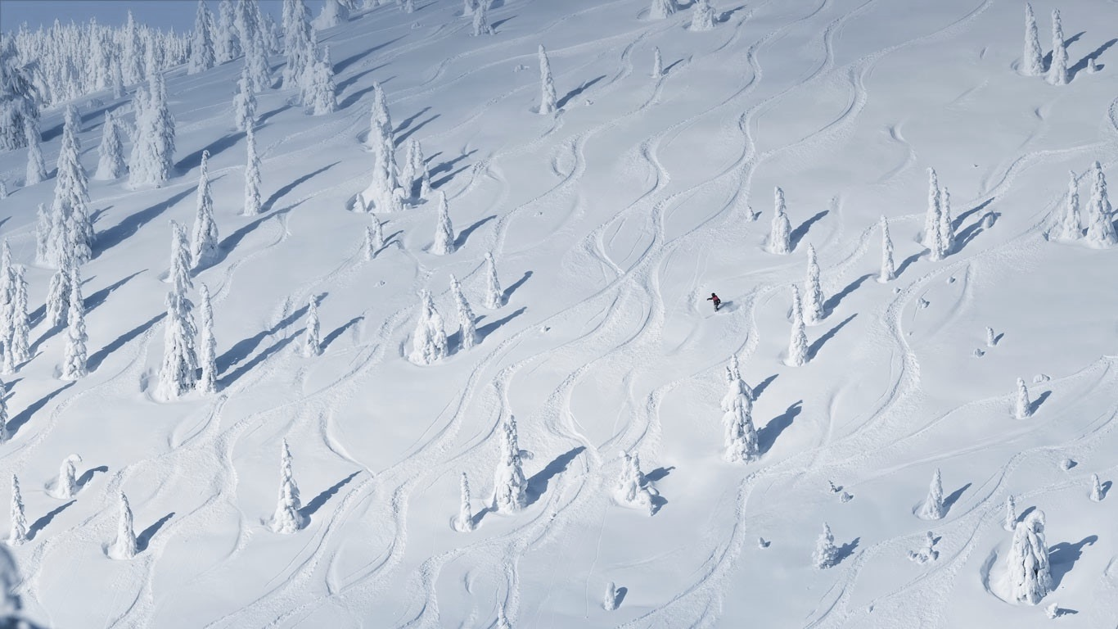
Abstract

Slide 4
Abstract
study a particular image-word relevance relation in this paper
Our results show that the word vectors of relevant tags for a given image rank ahead of the irrelevant tags, along a principal direction in the word vector space.
Solve image tagging by estimating the principal direction
linear mappings & Nonlinear deep neural networks
Superior performance for the conventional tagging task
Notes:
这篇文章主要介绍了一种独到的“图片-词汇”的相关关系
在主方向上，与给定图片相关的词向量tag排列在无关词向量tag之前
同时我们也解决了确定主方向的问题
除此之外，也开发出用来估计主方向的线性mapping与非线性的深度神经网络
结果显示，他不仅在卷积设置标签的任务上有更加优秀的表现，更在一些unseen tags的图像标注上由于其他很多基本方法

Slide 5
Introduction

Slide 6
Introduction
syntactic relation：
Dance - dancing ≈ fly - flying
use of word vectors in NLP
……
semantic relation
King - man ≈ queen - woman
However, it is unclear whether the visual regularities over words can still be encoded by the simple vector offsets
Notes:
文字向量在NLP(Natural Language Processing)中的使用较为广泛，例如语法相关与语义相关的一些词汇，但是尚不清楚一些隐含在图像中的，符合视觉规律的词汇是否仍然能够被解码

Slide 7
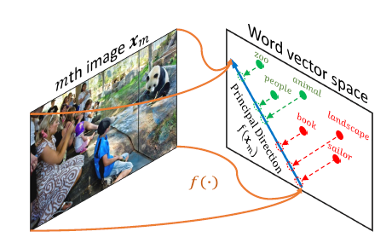
Introduction
Two disjoint sets
relevant tags
Y = {people; animal; zoo}
irrelevant tags
Y’ = {sailor; book; landscape}
Notes:
我们设置两个不相交的集合，不同于之前的语义与语法的关系，这里两个集合的关系更侧重于词汇的描述性和语义性，以及视觉联想性（即使粗糙的联系性）。

Slide 8
Introduction
Every image introduces a visual association rule (Y; Y ‘) over words.
The offsets between the vectors of the relevant tags Y and those of the irrelevant Y’ are along about the same direction, which we call the principal direction
There exists at least one vector (direction)w in the word vector space，such that its inner products with the vector offsets between Y and Y’ are greater than 0
Notes:
每个图像引入了一个视觉联想的规则：（Y;Y’）
在经过了一些经验驱动的检测之后，我们惊奇的发现，在某一方向上，相关的tag和无关的tag存在着抵消，该方向就被我们称为主方向
在每个词向量空间上至少存在一个主方向，以至于这些向量内积的值大于零

Slide 9
Introduction
Solve the image tagging problem by estimating the principal direction
Exploit linear mappings
and deep neural networks
Approximate the principal direction from each input image
Capable of assigning novel tags from an open vocabulary，which are unseen at the training stage
FastTag
Fast zero-shot image tagging
zero-shot learning
Notes:
我们需要通过确定主方向来解决图像标记的问题
特别地，我们开发了线性的mapping和深度神经网络来估算每张图片的主方向
这样的方式可以得到一些在训练过程中从未出现的新颖词汇
因为这样的方式集成了FastTag和zero-shot learning的优点，所以我们给他取名Fast zero-shot image tagging

Slide 10
Introduction
unseen tags are known a priori in order to tune the model towards their combinations.
Compared to the proposed method，
depends on two extra assumptions.
Test images are known a
priori, to regularize the model
Notes:
在我们之前的绝大多数实验，都是只能够进行已有标签的预测，当然，对于我们来说，还需要有两个额外的条件：
一是这些未出现过的标签是一些已有的先验知识，从而来调整整个model
二是图片同样是先验的，从而来对模型进行调整

Slide 11
Introduction
conventional tagging which assigns seen tags to images
the existing work tackles :with very few unseen tags
Zero-shot tagging which annotates images by (a large number of) unseen tags
3 different image
tagging scenarios:
Seen/unseen tagging which tags images with both seen and unseen tags

Slide 12
Related work

Slide 13
Related work
Zero-shot learning
Image tagging
Word embedding
Notes:
第三部分：相关工作，包括图片添加标签，词嵌入，和zero-shot学习

Slide 14
Related work
3.1 Image tagging
In the literature ：
approached from the tag ranking perspective
Image tagging aims to
assign relevant tags
to an image or to
return a ranking list of tags
In the generative methods：
involve topic models and mixture models ，the candidate tags are naturally ranked according to their probabilities conditioned on the test image.
Notes:
图片添加标签：目的是设置相关的tag，或者返回一个排序的标签序列

Slide 15
Related work
3.1 Image tagging
outperform
The nearest neighbor
based algorithms
generative models
but suffer from
high computation costs in
both training and testing.
faster and achieves comparable results
same level of low complexity
recent FastTag algorithm
recent FastTag algorithm
Notes:
基于最近相邻域的算法，比我们传统的生成模型表现更为出色，但是算法的复杂度较高
近期出现的FastTag算法，要比最近相邻算法更快，结果更好

Slide 16
Related work
3.2 Word embedding
Word embedding maps each word to a continuous-valued vector, by learning from primarily the statistics of word co-occurrences
In this paper, we further show that the simple linear offsets also depict the relatively coarser visual association relations in words.
Notes:
词嵌套结构，将每个单词映射为一个有连续值的向量，通过学习主要的词汇同现统计。
在这里，我们同时也表明，简单的线性抵消会展示单词间的一些模糊的视觉联想

Slide 17
Related work
3.3 Zero-shot learning
Zero-shot learning
zero-shot classification
special case
Zero-shot classification learns classifiers from seen classes and aims to classify the objects of unseen classes
word vectors
zero-shot classification‘s two main semantic sources
Attributes
Notes:
Zero-shot分类从可见的类学习分类器，并用于分类不可见的目标
Zero-shot分类的两大语义源：属性和词向量

Slide 18
The linear rank-ability of word vectors

Slide 19
The linear rank-ability of word vectors
3.1. The regulation overwords due to image tagging
3.2. Principal direction and cluster structure
3.3. Testing the linear rankability
hypothesis
Notes:
第三部分：相关工作，包括图片添加标签，词嵌入，和zero-shot学习

Slide 20
The linear rank-ability of word vectors
3.1. The regulation over words due to image tagging
S to denote the seen tags
U the tags unseen at the training stage
The conventional image tagging aims to assign seen tags in S to the test images
Noting that many fine-grained syntactic and semantic regulations over words can be expressed by linear word vector offsets, we next examine what properties the vector offsets could offer for this new visual association rule.

Slide 21
The linear rank-ability of word vectors
3.2. Principal direction and cluster structure
26,844 images
Validation set
NUS-WIDE
925 seen tags S
81 unseen tags U)
Objective: investigate, for any visual association rule (Ym; Ym’) in words by image m, the existence of the principal direction along which the relevant tags Ym rank ahead of the irrelevant tags Ym’.
Notes:
验证集：使用NUS-WIDE数据集
我们的目标是 测试图片中词汇的视觉联想规则，以及主方向的存在

Slide 22
The linear rank-ability of word vectors
3.3. Testing the linear rank-ability hypothesis
Principal direction
Mostly, the vector offsets point to about the same direction (relative to the origin), which we call the principal direction
two main structures from the vector offsets
Cluster structure （for future research）
There exist cluster structures in the vector
offsets for each visual association regulation over the words.
Notes:
向量抵消的两个结构：主方向和簇集结构

Slide 23
The linear rank-ability of word vectors
3.3. Testing the linear rank-ability hypothesis
To this end, we train a linear ranking SVM for each visual association rule using all the corresponding pairs (p;n), then rank the word vectors by the SVM, and finally examine how many constraints are violated.
In particular, we employ MiAP, the larger the better ，to
compare the SVM’s ranking list with those ranking constraints
We repeat the above process for all the validation images, resulting in 21,863 unique visual association rules.

Slide 24
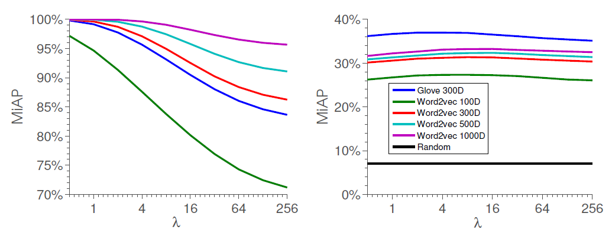
The linear rank-ability of word vectors
3.3. Testing the linear rank-ability hypothesis
Results.
The MiAP results averaged over all the distinct regulations are reported in Figure 3(left)
Showing that the seen tags S are linearly rank-able under almost every visual association rule—all the ranking constraints imposed by the relevant
Ym and irrelevant Ym’ tags to image m are satisfied.

Slide 25
The linear rank-ability of word vectors
3.3. Testing the linear rank-ability hypothesis
Generalization to unseen tags
This can be (only partially) justified by applying the ranking SVMs previously learned, to the unseen tags’ vectors, because we do not know the “true” principal directions
The results, shown in Figure 3(right), are significantly better than the most basic baseline, randomly ranking the tags (the black curve close to the origin), demonstrating that the directions output by SVMs are generalizable to the new vocabulary U of words.

Slide 26
The linear rank-ability of word vectors
3.3. Testing the linear rank-ability hypothesis
Observation.
Therefore, we conclude that the word vectors are an efficient media to transfer knowledge—the rank-ability along the principal direction—from the seen tags to the unseen ones
We have empirically verified that the visual association rule (Ym; Ym’) in words due to an image m can be represented by the linear rank-ability of the corresponding word vectors along a principal direction
words in total |S|+|U| = 1,006

Slide 27
Approximating the linear ranking functions

Slide 28
Approximating the linear ranking functions
4.1. Image tagging by ranking
4.2.Approximation by linear regression
4.3.Approximation by neural networks
Notes:
第五部分：估算线性排序函数
相关工作，包括图片排序添加标签，线性回归估算，神经网络估算

Slide 29

Approximating the linear ranking functions
4.1. Image tagging by ranking
The main idea is to approximate the principal direction by learning a mapping function f(.), between the visual space and the word vector space, such that
the visual feature representation of the image m.
We explore both linear and nonlinear neural networks for implementing the approximation function f(x) ≈ w.
Notes:
主要的思想：学习一个在视觉空间和向量空间的映射函数

Slide 30


Approximating the linear ranking functions
4.2. Approximation by linear regression
Here we assume a linear function from the input image representation x to the output principal direction w
can be solved in a closed form by linear regression.
Accordingly, we have the following from the training
where Wm is the principal direction of all offset vectors of the seen tags

Slide 31
Approximating the linear ranking functions
4.2. Approximation by linear regression
There are thus two stages involved to learn the linear function f(x) = Ax
The first stage trains a ranking SVM
over the word vectors of seen tags
for each visual association (Ym; Ym’).
two stages
2.The second stage solves for the
mapping matrix A by linear regression,
in which the targets are the directions
returned by the ranking SVMs.

Slide 32
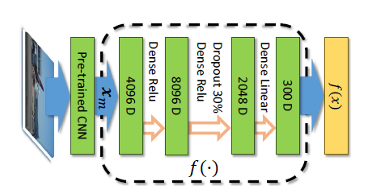
Approximating the linear ranking functions
4.3. Approximation by neural networks
We also exploit a nonlinear mapping f(x; Ø) by a
multilayer neural network, where Ø denotes the
network parameters.
It consists of two RELU layers followed by a linear layer to output the approximated principal direction, w, for an input image x.
We expect the nonlinear mapping function f(x; Ø) to offer better modeling flexibility than the linear one

Slide 33
Approximating the linear ranking functions
4.3. Approximation by neural networks
Practical considerations
We use Theano to solve the optimization problem. A mini-batch consists of 1,000 images, each of which incurs on average 4,600 pairwise ranking constraints of the tags—we use all pairwise ranking constraints in the optimization.
Without the normalization the MiAP results drop by about 2% in our experiments.
early stopping
For regularization
dropout layer with
the drop rate of 30%.

Slide 34
Experiments

Slide 35
Experiments
5.1. Dataset and configuration
5.2. Conventional image tagging
5.3 Zeroshot and Seen/Unseen image tagging
Notes:
第六部分：实验
1.数据集和配置
2.卷积图像添加标签
3.zero-shot和seen/unseen 图片添加标签

Slide 36
Experiments
5.1. Dataset and configuration
NUS-WIDE
80% ：training data
training set with 134,281 images
dataset
20% ：validation data
test set with 89,603 images

Slide 37
Experiments
5.1. Dataset and configuration
Annotations of NUS-WIDE
first set comprises of 81 “groundtruth” tags.
carefully chosen to be representative of the Flickr tags, such as containing both general terms (e.g., animal) and specific ones
NUS-WIDE
Second:1,000 popular Flickr
tags
2,3 dataset harvested from Flickr
Third:nearly 5,000 raw tags

Slide 38
Experiments
5.2. Conventional image tagging
Here we report the experiments on the conventional tagging.
The 81 concepts with “groundtruth” annotations in
NUS-WIDE are used to benchmark different methods
TagProp
CCA
competitive
baseline.
WSABIE
WARP
FastTag

Slide 39
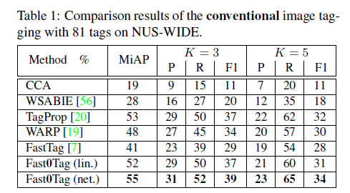
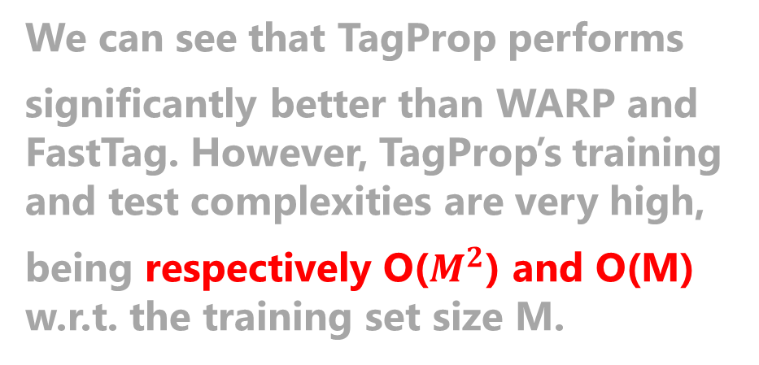
Experiments
We can see that TagProp performs
significantly better than WARP and FastTag. However, TagProp’s training and test complexities are very high,
being respectively O($M^{2}$) and O(M) w.r.t. the training set size M.
5.2. Conventional image tagging
Results.
outperforms
the other methods
Fast0Tag
have as low computation complexities as WARP and FastTag.

Slide 40
Experiments
5.3. Zero-shot and Seen/Unseen image tagging
This section presents some results for the two novel image tagging scenarios, zero-shot and seen/unseen tagging
Seen2Unseen.
LabelEM.
Baselines
LabelEM+.
ConSE.

Slide 41
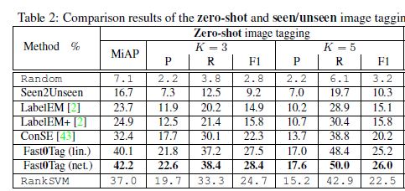
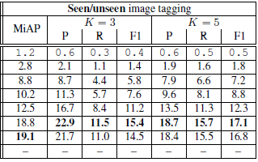
Experiments
5.3. Zero-shot and Seen/Unseen image tagging
Table 2 summarizes the results of the baselines and Fast0Tag when they are applied to the zero-shot and seen/ unseen image tagging tasks. Overall, Fast0Tag, with either linear or neural network mapping, performs the best

Slide 42
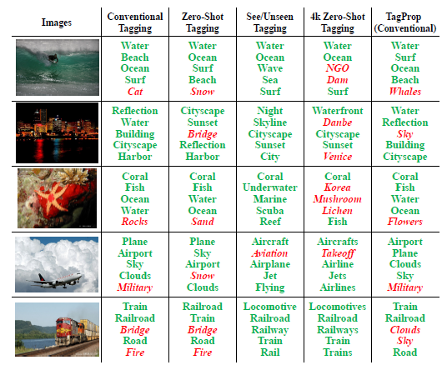
Experiments
5.3. Zero-shot and
Seen/Unseen image tagging
Qualitative results.
The tags in green color
appear in the groundtruth annotation; those in red color and italic font are the mistaken tags. Interestingly, Fast0Tag performs equally well for traditional and zero-shot tagging and makes even the same mistakes. More results are in Suppl

Slide 43
Conclusion

Slide 44
Conclusion
A particular visual regulation over words
the visual association rule which partitions words into two disjoint sets according to their relevance to an image
how it can be captured by the vector offsets in the word vector space
There exists a principal direction in the word vector space
involve 1,006 words
develop a Fast0Tag model to solve image tagging by estimating the principal directions for input images

